Slide 1

Workers App
Port City International University​
Easily find your expert near you

Slide 2
Submitted to
Mumtahina Ahmed
Lecturer, Department of CSE
Presented By
Ayan Kumar Dey (CSE-01806659)
Souman Barua (CSE-01806660)
Sanjoy Barua (CSE-01806661)
Shihab Hossain (CSE-01806670)

Slide 3
Outline
Problem Statement
Motivation
Aims and Objective
Software Tools
Software Design: ER Diagram
System Implementation: Screen shorts
System Testing
Conclusion and Future Work

Slide 4
Problem Statement
We need help from different types of workers everyday.Workers like Plumber,Electrician,house painter,Mason help us in our life. But it is not easy to find experts especialy in new area.
So it will be easy and efficient if we can find workers in our area near our house also can see how effective they are workers app helps us to find our experts very easily

Slide 5
Motivation
This day it is very hard to find good workers to do your job
This app reduce the stress to find experts save time to find good workers
By this app you will be able to see all the workers in your area so you can choose the best one to do your job

Slide 6
Aims and Objective
Visitor Feature:
Workers app helps you to find experts like electrician, plumber, Carpenter, Movers ,Mason ,Painters ,Cleaners in your area.
You can find experts near you based on your location
The worker will have ratings workrate so you can know how good they are.
You can easily find your worker and get their contract number.
Workers Feature:
Easily create account .
Update your skills and get hired.
Get Reviewed and rank your profile up

Slide 7
Software Tools
The system has been developed using
Kotlin
Firebase
Android Studio
The system will able to process and update the database with more ease. It helped in developing a total integrated system.

Slide 8
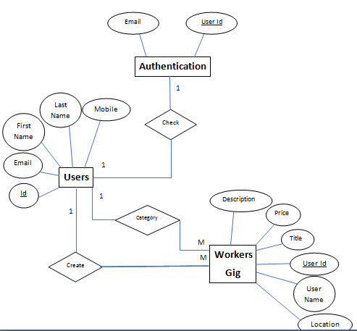
System Design: ER Diagram

Slide 9
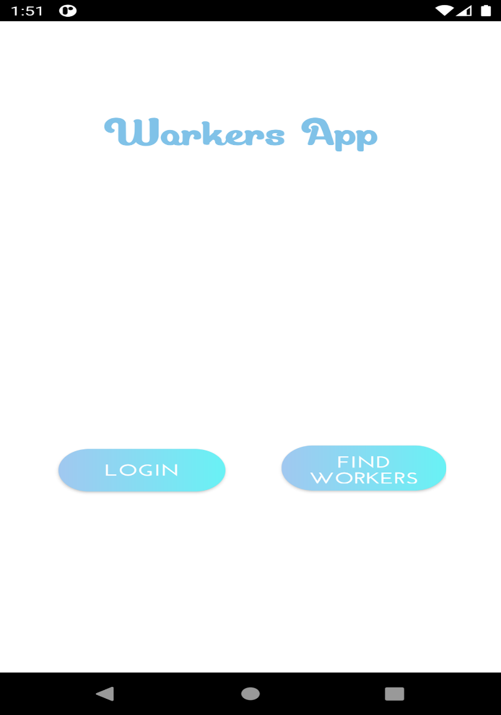
System Implementation
.
Figure 1.1: Welcome Screen

Slide 10
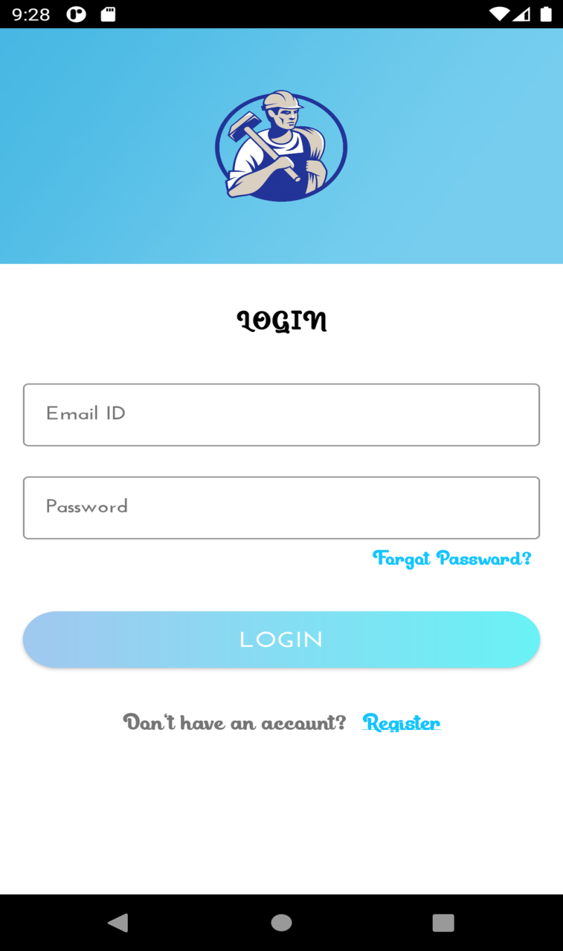
Figure 1.2: Log in Screen.

Slide 11
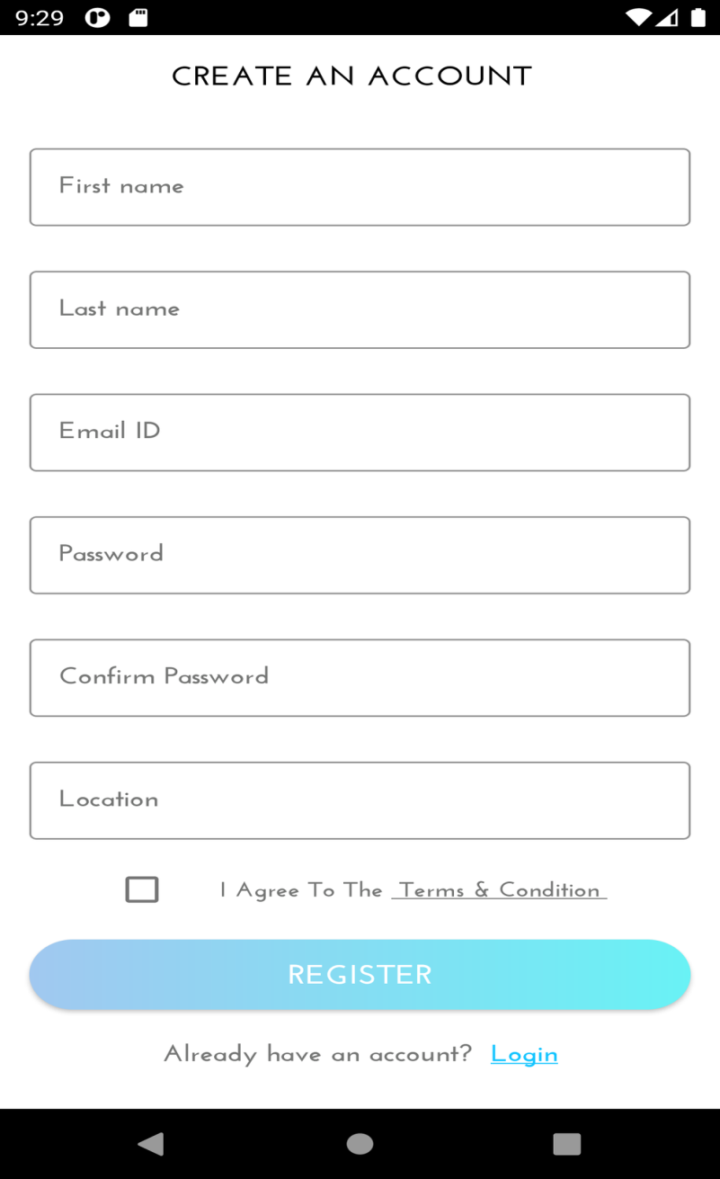
Figure 1.3: Sign Up Screen.

Slide 12
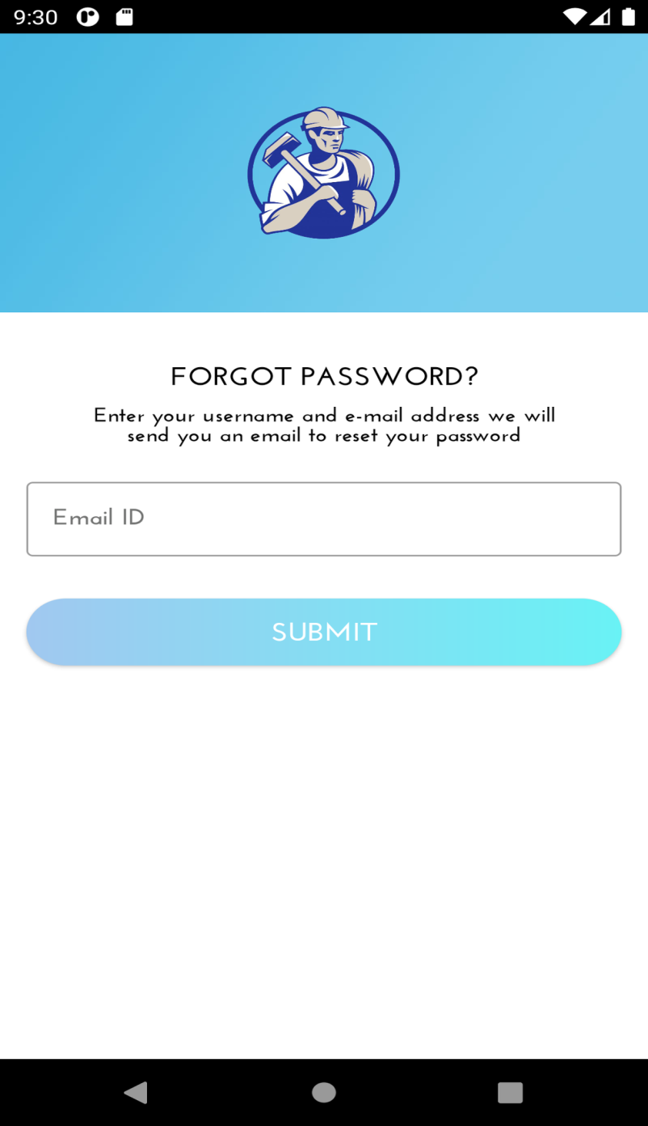
Figure 1.4: Forget Password.

Slide 13
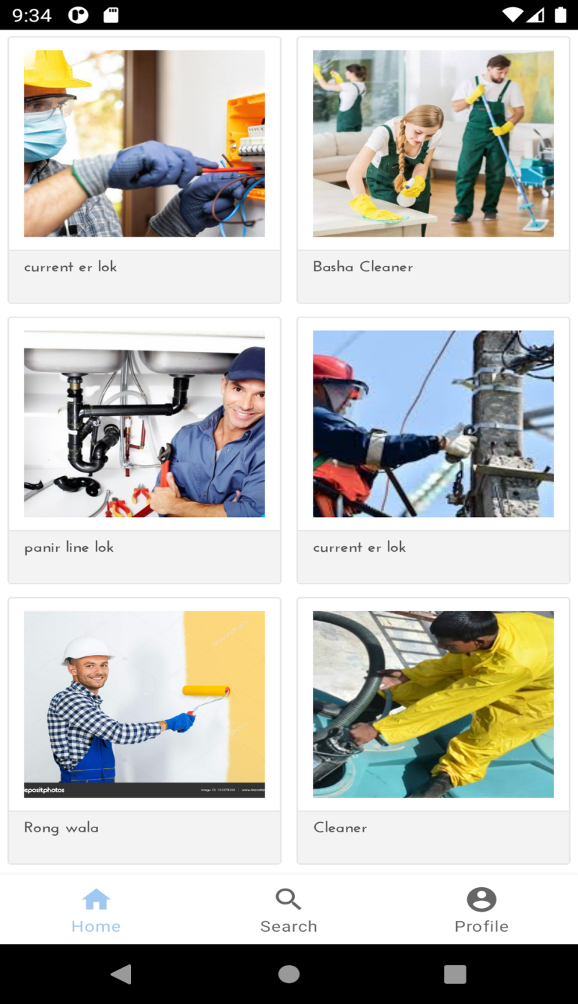
Figure 1.5: Home Screen.

Slide 14
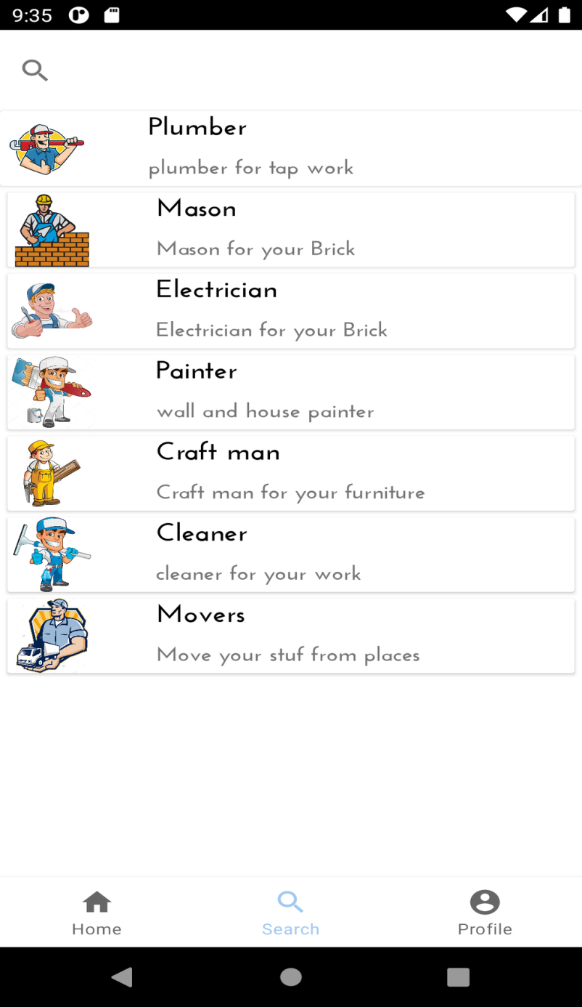
Figure 1.6: Category fragment

Slide 15
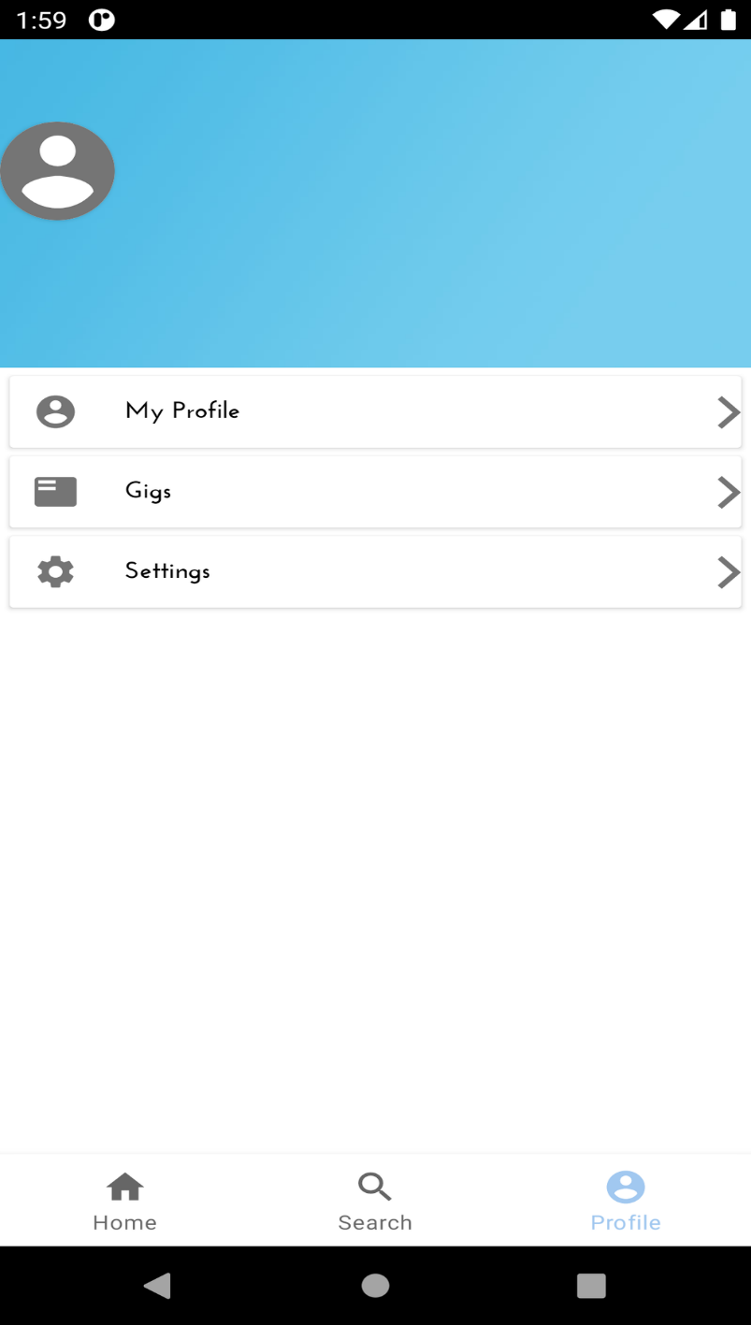
Figure 1.7: Profile fragment

Slide 16
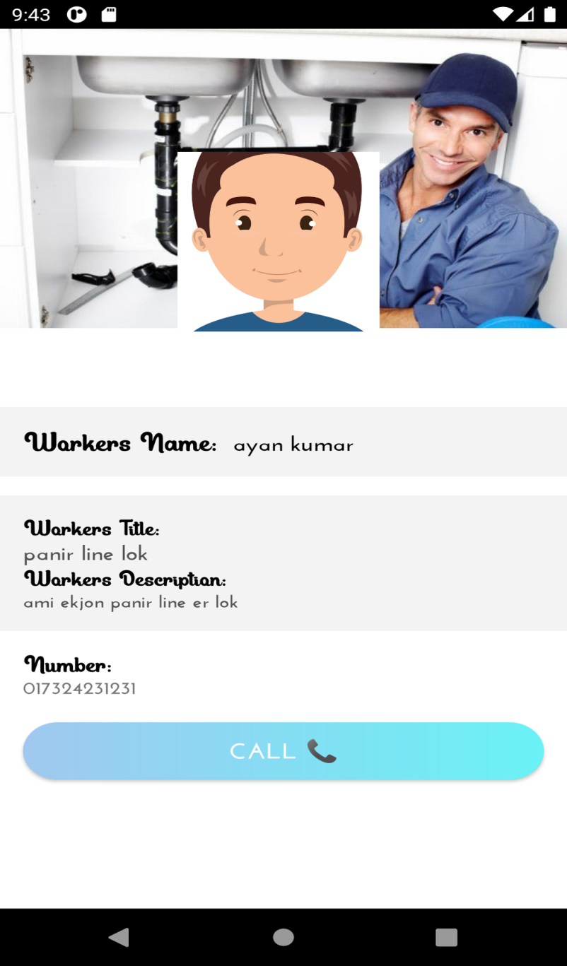
Figure 1.8: Gig detail

Slide 17
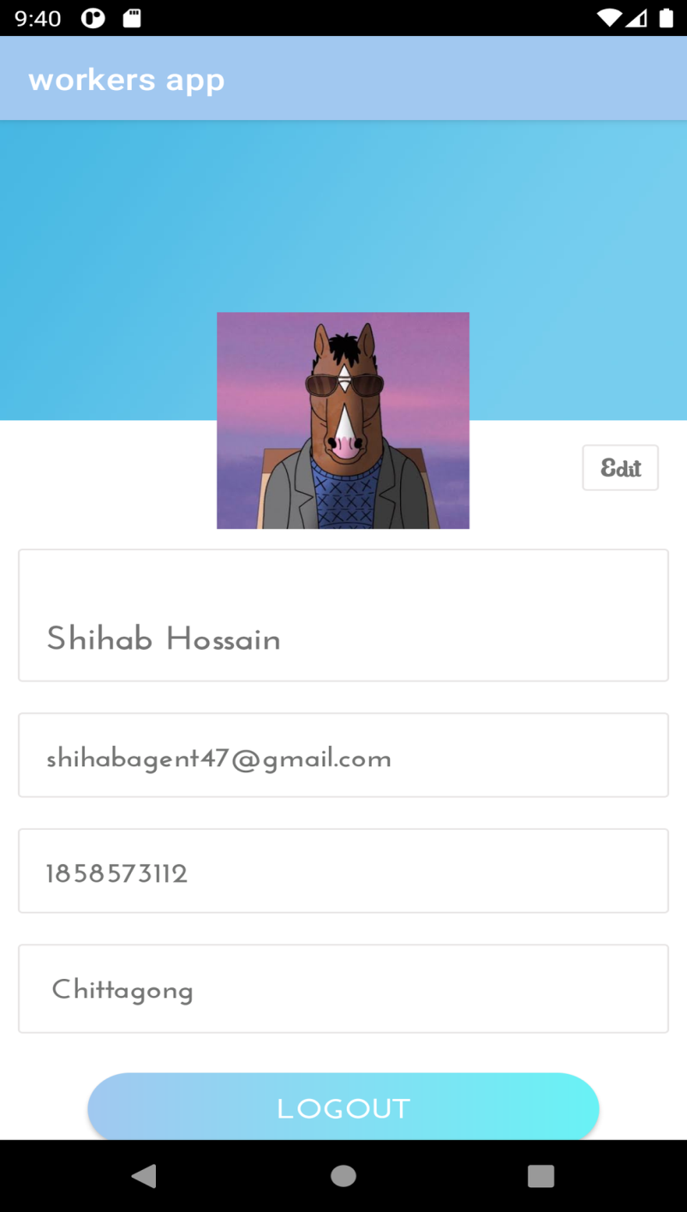
1.9: Profile

Slide 18
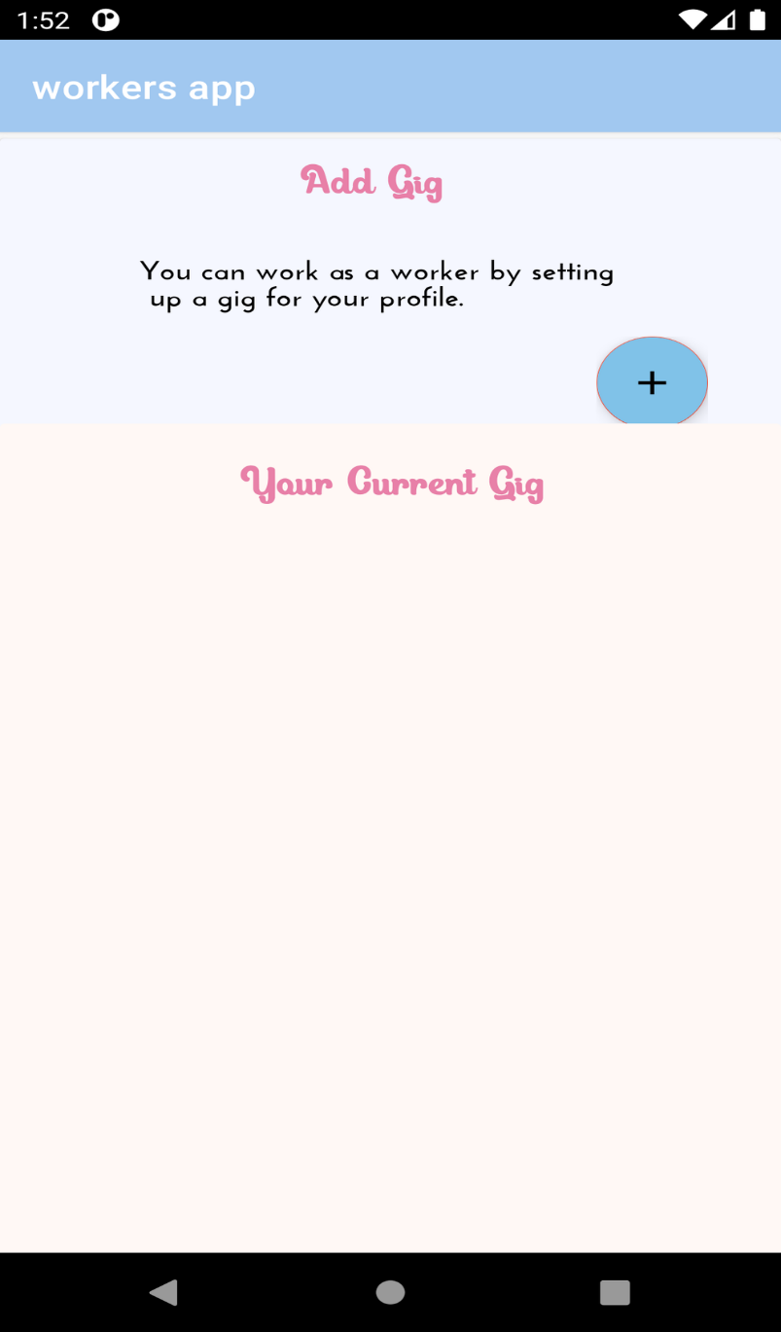
Figure 1.10: Gig Activity.

Slide 19
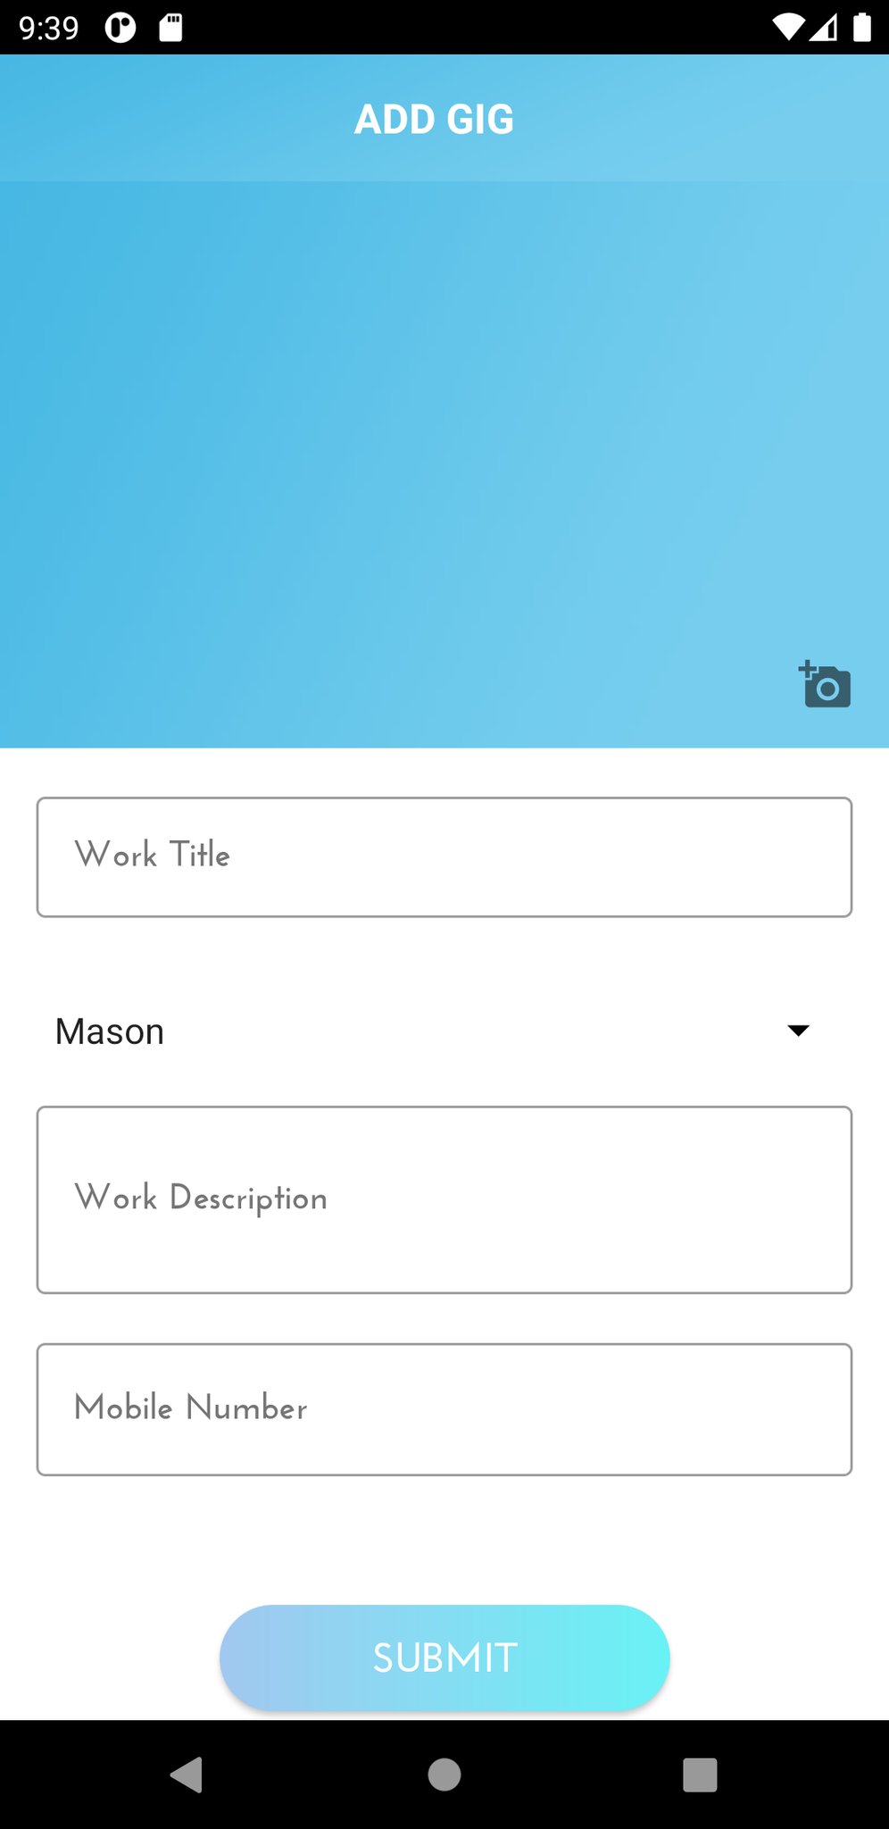
Figure 1.11: Adding Gig.

Slide 20
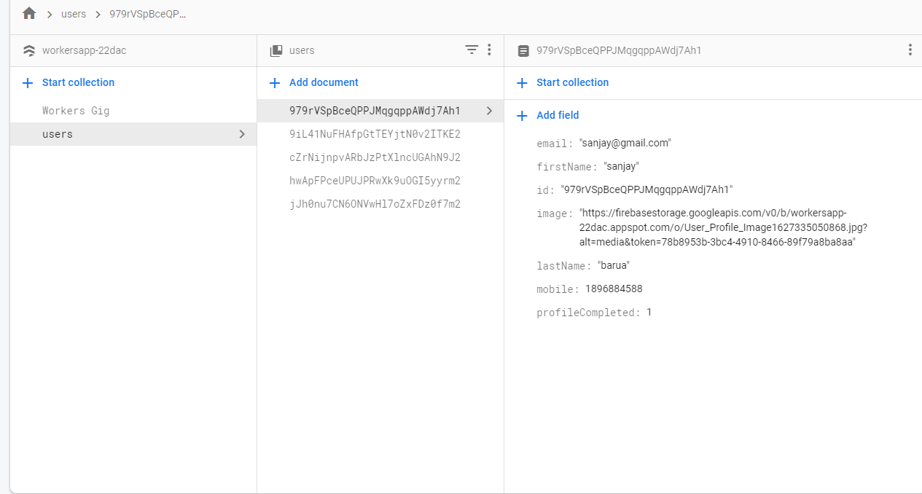
1.12: Database for User

Slide 21
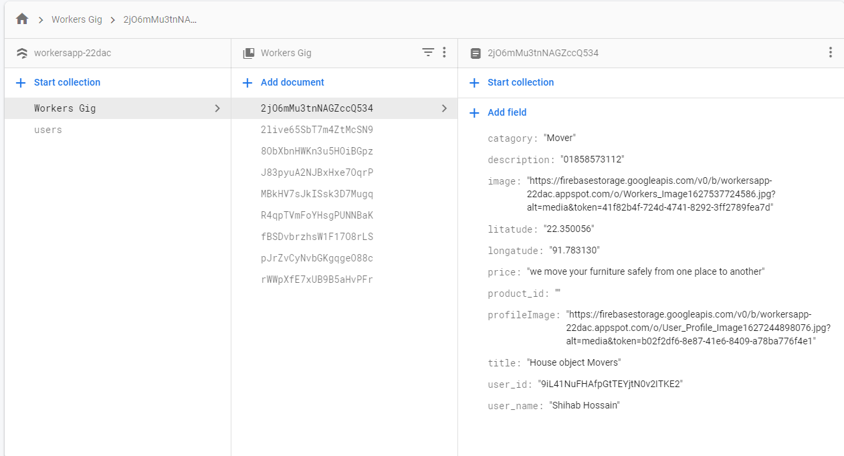
1.13: Database for Workers

Slide 22
System Testing
In our daily life we face different types of problem fixing things around us(for example light, fan, pipe etc) because most of the time we don’t have the correct information about the workers around us. Because of workers app ,we can get the information about the workers around us and seek help from them whenever we need. A workers app refers to an app which will have information about all kinds of workers around us.

Slide 23
System Testing
Location: The workers app need gps connection to find workers near you.So it always need to access your gps.
Authentic information of Workers : Find workers doesn’t take the voter id of the workers so it can not validate their identity. It only shows workers information based on what they entered
Authentic information of Users :Find workers doesn’t take the voter id of the users so it can not validate their identity. It only take user information based on what they entered .
Internet Connection : Find workers app need internet connection to find the workers. It wont work in offline .

Slide 24
Conclusion This is a project to help peoples around the world to find the workers near then. This app will help us to save time and our energy to find our experts. The workers can get new work opportunity and they can find new works. This app saves time for both parties. This app is solution for worker as well as for the users. Future Work There will be many exciting features coming up for this app development era. The list of the features which can be added to the app in future are: 1.Add ratings for the users so they can rate workers based on their time. 2.Improved algorithm so the users can find worker based on their activity. 3.Fixing the bugs which occour. 4.Add search option. There are yet more to come after the customers demand.

Slide 25
Thank You

